Slide 1


Container Congestion Predictor & Port Operations Optimiser
AI-Powered Port Congestion Intelligence & 72-Hour Operations Planning

Slide 2










The Problem: Port Congestion Creates a Chain Reaction
Vessel Arrivals
Growing Queue
Berth Bottleneck
Higher Costs
High density
Wait times surge
Resource conflict
Operational delay
Who is affected?
Why does it matter?
Port operators, terminal planners, vessel operators, and logistics teams managing tight turnaround schedules.
A single operational bottleneck triggers a wider chain reaction across entire port networks, escalating demurrage costs.
"The challenge is not just detecting congestion — it is deciding what to do next."

Slide 3
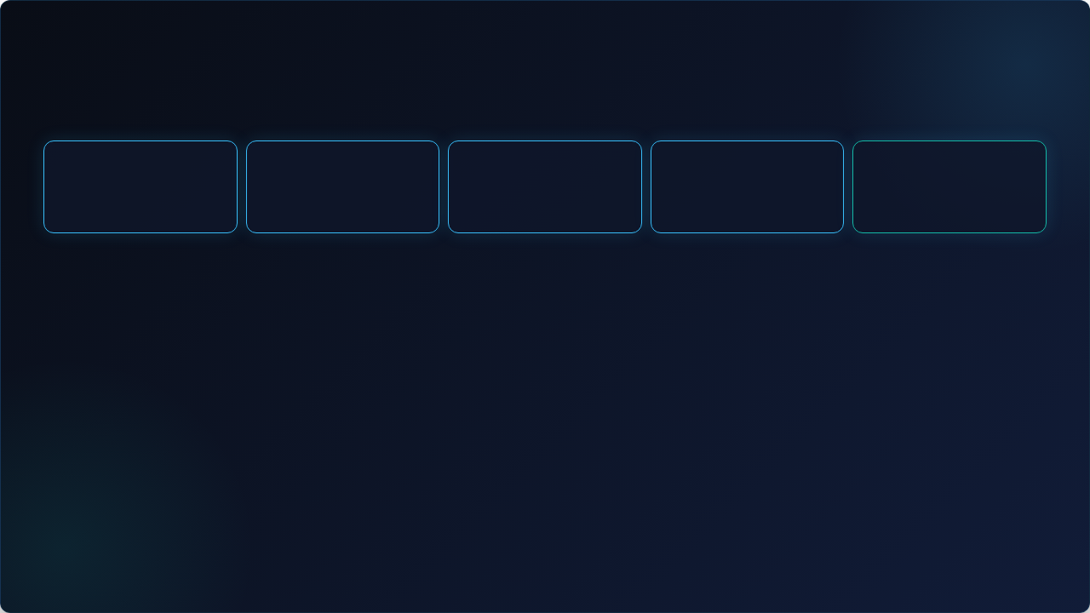


Our Solution: From Congestion Prediction to Action
Port Data
AI Prediction
Route Recs
Optimization
72-Hr Plan
PREDICT
RECOMMEND
OPTIMIZE
PLAN
Identify LOW, MEDIUM, or HIGH congestion states across terminals.
Suggest optimal routes based on wait time, congestion, and cost.
Assign berths & cranes using real-time availability and priority.
Generate comprehensive 72-hour operational schedules instantly.
"Turn operational data into actionable port decisions."

Slide 4








Architecture: Data → AI → Optimization → Operations
DATA
BACKEND
AI ENGINE
FRONTEND
Vessels
FastAPI
Congestion Scoring
React + TS
Berths
Vessel APIs
Live Dashboard
Cranes
Assignment Logic
Route Recs
What-If Simulator
Port Traffic
Simulation Engine
Resource Solver
Schedule View
72-Hour Scheduler

Slide 5













Key Feature: AI-Powered Congestion & Operations Dashboard
CONGESTION SCORE
ACTIVE VESSELS
AVAILABLE BERTHS
AVAILABLE CRANES
24 In Queue
84.2 / HIGH
3 / 12 Free
18 Active
Live AI Recommendations
72-Hour Operations Timeline
Reroute MSC Orion to Berth 4
Day 1: Peak Inflow Mitigation
Reallocate Crane C2 to Terminal B
Day 2: Berth Balancing Schedule
Day 3: Turnaround Normalization
Delay arrival window for CMA CGM
"One operational view for faster, data-driven port decisions."

Slide 6




IBM Technology: How BoB Accelerated Development
BoB-Assisted Dev
Testing & Refinement
Working Prototype
Requirements
Implementation
Rapid Scaffolding
Logic & Debugging
Frontend Integration
Accelerated initial architectural setup and FastAPI boilerplate generation.
Streamlined optimization algorithm structuring and edge-case testing.
Assisted component design and state synchronization for the React dashboard.
"IBM BoB was integrated into our development workflow to accelerate building, testing, and refining the working solution."

Slide 7



Impact: Turning Port Data into Faster Decisions
BEFORE
AFTER
Reactive decision-making under heavy queues
Predict → Recommend → Optimize → Plan workflow
Siloed data across berths and vessel operators
Early congestion awareness & preemptive routing
Delayed awareness of developing bottlenecks
72-hour continuous operational visibility
What-if simulation before changing operations
Manual, trial-and-error scheduling methods
"The goal is not only to predict congestion — it is to help operators act before congestion becomes disruption."

Slide 8







Team: Building Smarter Port Operations
Shubham Mavani
Krish Goti
Kavya Mehta
Gurjar Navneet
Core Development
AI & Optimization
Frontend & UI
Architecture & Data
Container Congestion Predictor & Port Operations Optimiser • Predict. Recommend. Optimize. Plan.

